Slide 1
AEGNN
Asynchronous Event-based Graph Neural Networks
A Review of Simon Schaefer, Daniel Gehrig, Davide Scaramuzza CVPR 2021

Slide 2
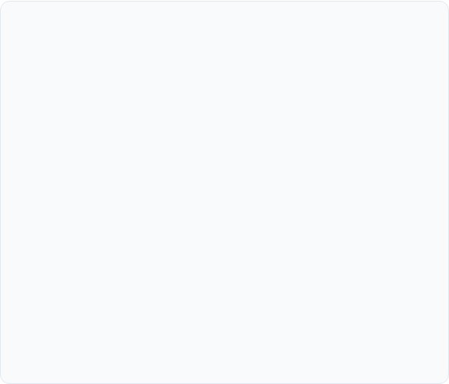
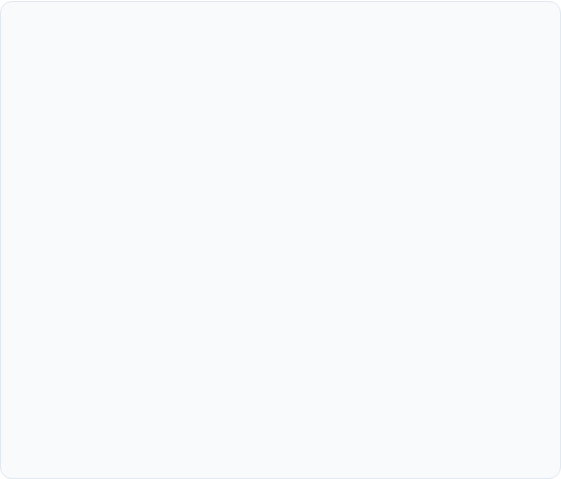
The "Wasteful Computation" Problem
Standard Dense Methods
The AEGNN Solution
Traditional approaches convert sparse event streams into dense image-like grids.
AEGNN processes events as evolving spatio-temporal graphs.
The Problem: This discards the inherent sparsity of the data and forces the processing of empty pixels (zeros), leading to high latency and unnecessary power consumption.
The Innovation: It updates activations asynchronously. When a new event arrives, we only recompute the local neighborhood, preserving the microsecond-resolution and sparsity of the sensor.

Slide 3
Contributions
Novel paradigm for processing events sparsely and asynchronously as temporally evolving graphs
Efficient update rules
AEGNN can be trained on synchronous event-data and tested asynchronously
needed for GPU dependency
Application of AEGNN for object recognition/detection.
200x less compute for recognition
21x less compute for detection

Slide 4
Spreadsheet Analogy
Suppose you have a giant spreadsheet
Synchronous training
everytime you add 1 number, you force the computer to recalculate every single cell in the entire sheet.
Safe and easy to implement, but has a high cost
Asynchronous deployment
“I added a number in cell A3. Only cell B4 depends on A3 and only cell C5 depends on B4.” → only update those 3 cells
Both have the same result

Slide 5
Strongest takeaway of this paper
graphActivations(whole_static_batch) = graphActivations(event_by_event)

Slide 6
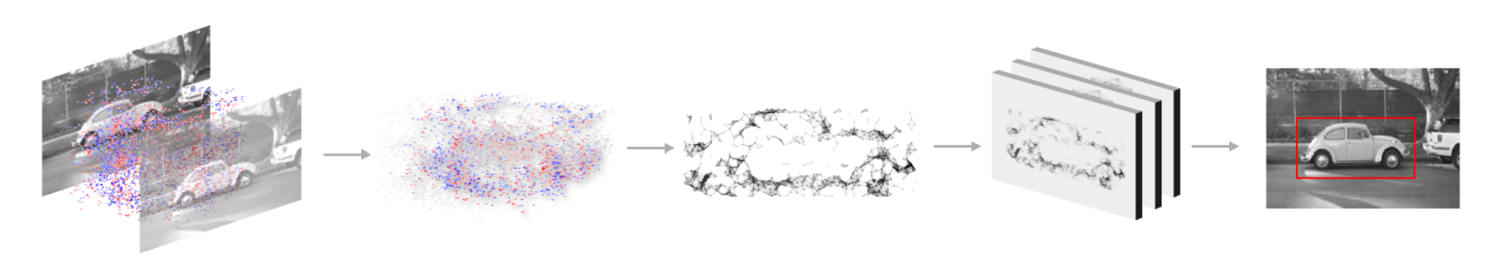

Slide 7
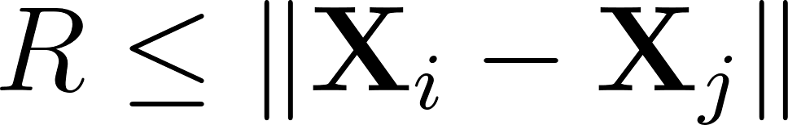
Graph Construction
Events are embedded as nodes in a spatio-temporal graph G = (V,E) where the edges are directed
Events are subsampled by a factor of 10 to prevent overfitting
Radius Search: Edges are created between events that fall within a defined spatio-temporal radius , linking simultaneous and spatially close events.
Temporal Normalization: Time is scaled by to match spatial dimensions.
Each vertex X_{i} = (x_{i}, y_{i}, t*_{i}) with t*_{i} = βt_{i}

Slide 8
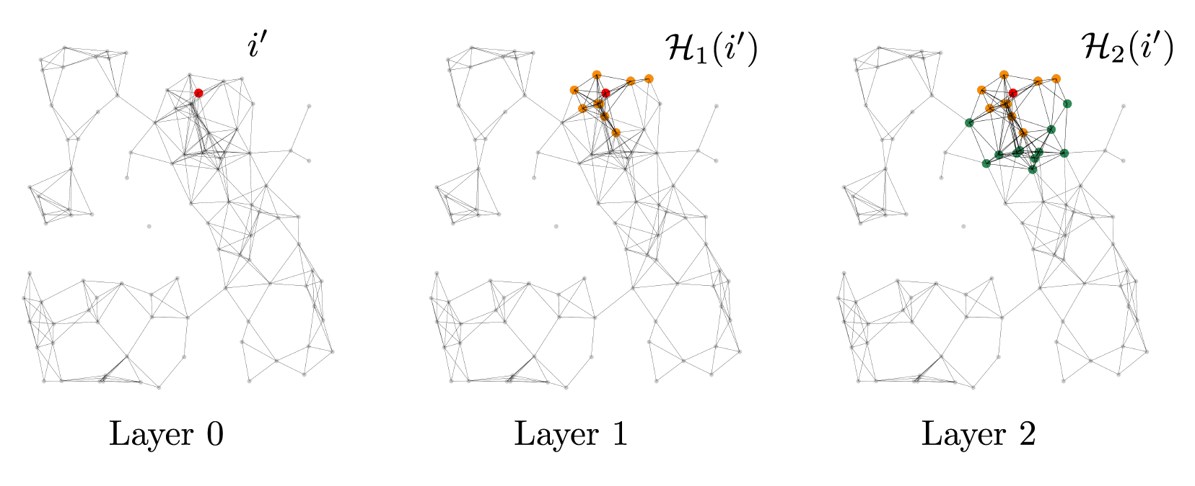
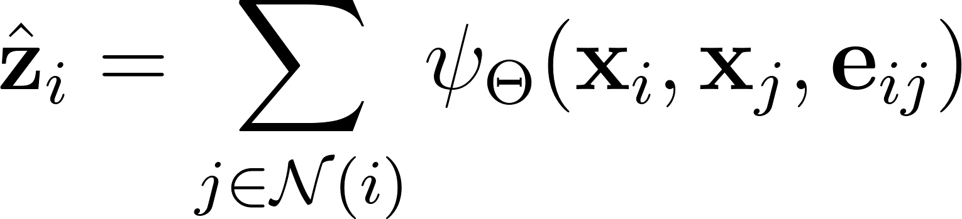
Asynchronous Update Rule
Instead of recomputing the entire graph for every new event, AEGNN exploits locality via recursion
Locality: A new event only affects its immediate neighbors.
Sparse Propagation: In Layer 1, only the 1-hop subgraph updates. In Layer k, only the k-hop subgraph is recomputed.
•
Result: activation computation depends on subgraph size, not total graph size.
Therefore, a full graph update is equivalent to a 1-hop subgraph update from the new vertex

Slide 9
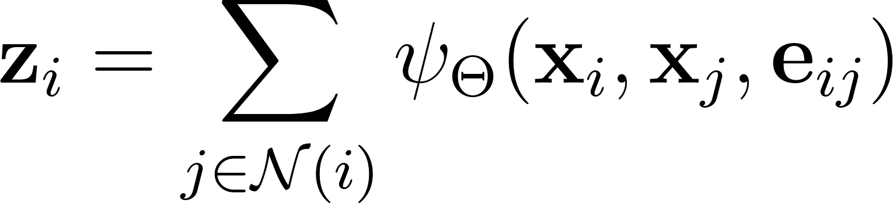
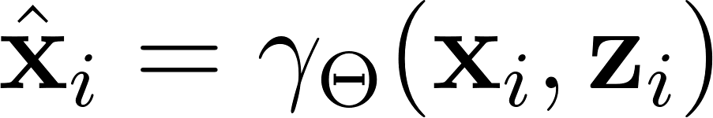
Graph Convolutions
for each node i in Graph
function ψ computes messages based on pairs of neighbors
messages depend on node features at these nodes/edge and how i,j are spatially arranged
all messages are aggregated via summation
passed through function γ_{θ} → new value for node i

Slide 10
Graph Convolution Analogy
Social network of voters
you are node i and are trying to decide your political stance (node value/features). Suppose you’re undecided (0.5)
Neighbors: One friend is very right (x_{j} = 1) another is very left (x_{k}=0)
edge: the relationship.
Computing messages (ψ)
don’t copy your neighbors but rather interpret them based on who they are and where they stand relative to you
normal GNN: your right says “I voted for A”. The message is just their value.
AEGNN (Spline convs):

Slide 11
Spline Convolution: paying attention to spatial arrangement
the edge isn’t just a line but rather a vector describing geometry (neighbor j is 4 pixels up and 35 μs in the past)
ψ says if the neighbor is to my left (spatial) treat their opinion differently than if they are to my right
You might trust advice from a close neighbor more than a distant neighbor
after summation you get your total message z_{i}
The update (γ_{θ}): given your own previous opinion (0.5) and z_{i} you need to make your final value.
MLP to combine internal state and external node info

Slide 12
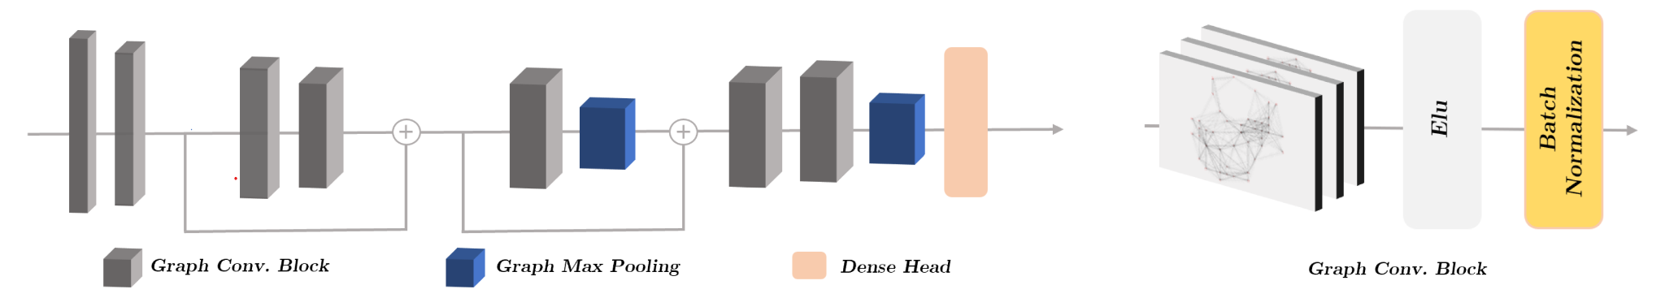
Network Architecture

Slide 13
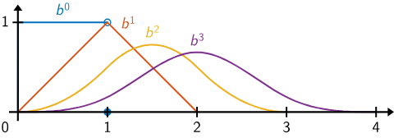
Network Architecture
Spline Convolutions
The authors use spline convolutions instead of standard GNN operators. This allows the network to learn from the continuous relative positions of nodes, preserving the precise spatial layout of the visual data. GNN methods don’t do this.
Voxel-Grid Pooling
To enable hierarchical learning, they employ a grid-based pooling strategy. Nodes within a defined spatio-temporal voxel are clustered, and their features aggregated via a max operation. This step is also updated asynchronously.

Slide 14
Training details
Adam optimizer
lr = 10⁻³
Quadro RTX

Slide 15
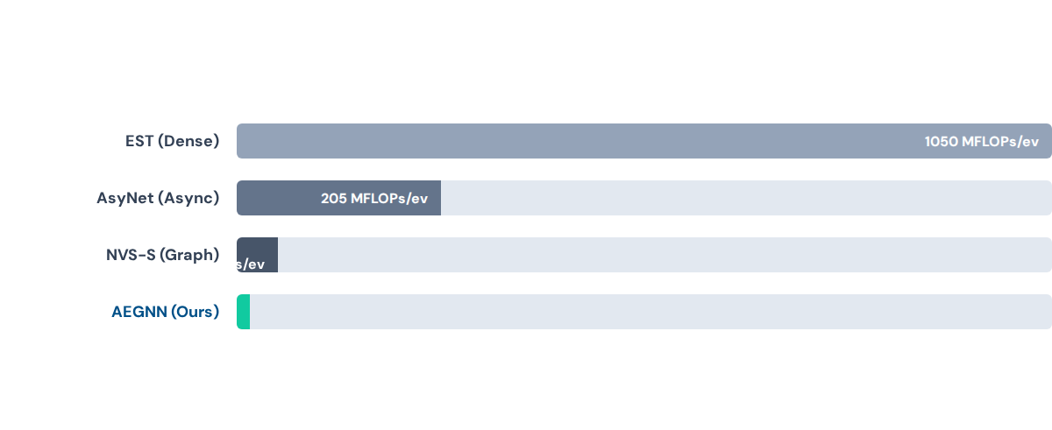
Efficiency: N-Cars Recognition
AEGNN achieves state-of-the-art accuracy with a fraction of the computational cost.
AEGNN requires ~200x less compute than the next best graph-based method while maintaining high accuracy.

Slide 16
Object Detection
They applied AEGNN to bounding box detection on the Gen1 Automotive dataset.
•
Higher Accuracy: Outperforms state-of-the-art asynchronous method (AsyNet) by 3.4% mAP.
•
Lower Latency: Processing 25,000 events takes only 129ms compared to 1014ms for a standard dense GNN.
•
Efficiency: Uses only 0.39 MFLOPs/event.

Slide 17





Key Takeaways
Efficient
Fast
Scalable
200-fold reduction in computational complexity (FLOPs) compared to dense methods.
8-fold reduction in computational latency, enabling real-time robotics applications.
Enables deep, hierarchical learning on event data without losing temporal resolution.

Slide 18
Project Page: uzh-rpg.github.io/aegnn/
Thank you for your attention.
Paper: AEGNN: Asynchronous Event-based Graph Neural Networks (CVPR)

